Slide 1
Spring Batch

Slide 2
What is Spring Batch ?
Spring Batch is an open source framework for batch processing.
It provides reusable functions that you can use to process large volumes of records.
Spring Batch works by first reading items from a specified source. Then in a next step, the items are processed. And finally, the processed items are written to a specified destination.

Slide 3
Why Spring Batch Useful ?
Chunk Processing :If there are million records to be written to the storage a practical idea to split it into manageable chunks of 1000 records each, and write these chunks one at a time. Even if one such chunk fails, the other operations are not affected.

Slide 4
Understanding Spring Batch :
A Job in Spring Batch is nothing but a sequence of Steps. Each Step can be configured before execution, with the following attributes:
next: The next Step to execute
tasklet: The task that needs to be done as part of this Step. decision: This decides in which situations this Step needs to be run
The Job Instance
A Job Launcher is used in order to execute a Spring Batch Job. Note the
following points about a Job thus created:
Each execution of a Job is called a Job Instance. Each Job Instance is provided with a unique execution id, which is useful to restart the job if it fails. A Job can be configured with parameters. These can be passed to it from the Job Launcher.

Slide 5
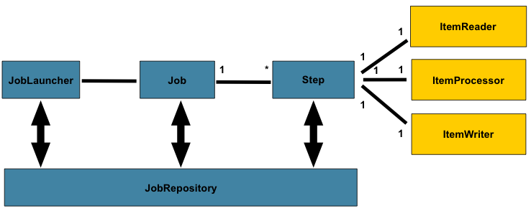
Working of Spring Batch :

Slide 6
Annotations :
@EnableBatchProcessing : It will enable batch processing features and base configurations
@Scheduled : It is used to schedule particular job.

Slide 7
Main Approaches to build Steps :
Tasklet Based
Chunk Based

Slide 8
Tasklet Based :
Tasklets are meant to perform a single task within a step. Our job will consist of several steps that execute one after the other. Each step should perform only one defined task.
A Tasklet supports a simple interface that has only one method, execute(), which is called repeatedly until it either returns RepeatStatus.FINISHED or throws an exception to signal a failure.

Slide 9
Chunk Oriented Processing :
Chunk Oriented processing,refers for reading the data sequentially and creating chunks that will be written out within transaction boundry
Each individual item is read in from an ItemReader, handed to an ItemProcessor, and aggregated.
Once the number of items read equals the commit interval, the entire chunk is written out via the ItemWriter, and then the transaction is committed.

Slide 10
ItemReader
In order to read a list of customers from an XML file, we need to provide an implementation of the interface org.springframework.batch.item.ItemReader
It is typically called multiple times for each batch, with each call to read() returning the next value and finally returning null when all input data has been exhausted.
Spring Batch provides some out-of-the-box implementations of ItemReader, which can be used for a variety of purposes such as reading collections, files, integrating JMS and JDBC as well as multiple sources, and so on

Slide 11
ItemProcessors :
ItemProcessors transform input items and introduce business logic
The method process() accepts one instance of the I class and may or may not return an instance of the same type.
Returning null indicates that the item should not continue to be processed.

Slide 12
ItemWriter
The write() method is responsible for making sure that any internal buffers are flushed.

